Slide 1
Object Oriented Programming—C++ Lecture5 Iterators and Pointers
Qijun Zhao
College of Computer Science
Sichuan University
Spring 2023

Slide 2
Recap
Containers
● Containers are ways to collect related data together
and work with it logically
● Two types of containers: sequence and associative
● Container adaptors wrap existing containers to permit
new/restrict access to the interface for the clients.

Slide 3
There are two types of containers:
Sequence:
● Containers that can be accessed
sequentially
● Anything with an inherent order
goes here!
Associative
● Containers that don’t necessarily have a sequential order
● More easily searched
● Maps and sets go here!

Slide 4
Sequence Containers: Summary
● Sequence containers are for when you need to enforce some order on your information!
● Can usually use an std::vector for most anything
● If you need particularly fast inserts in the front, consider an std::deque
● For joining/working with multiple lists, consider an std::list (very rarely)

Slide 5
Choosing associative containers
Lots of similarities between maps/sets! Broad tips:
● Unordered containers are faster, but can be difficult
to get to work with nested containers/collections
● If using complicated data types/unfamiliar with hash
functions, use an ordered container

Slide 6
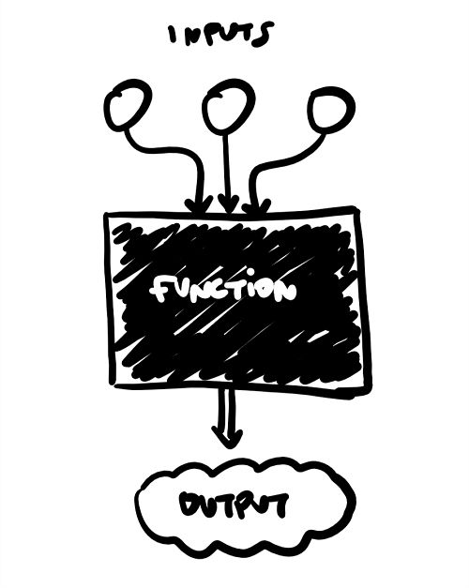
Container Adaptors
Container adaptors are “wrappers” to existing containers!
● Wrappers modify the interface to sequence
containers and change what the client is allowed to
do/how they can interact with the container.

Slide 7
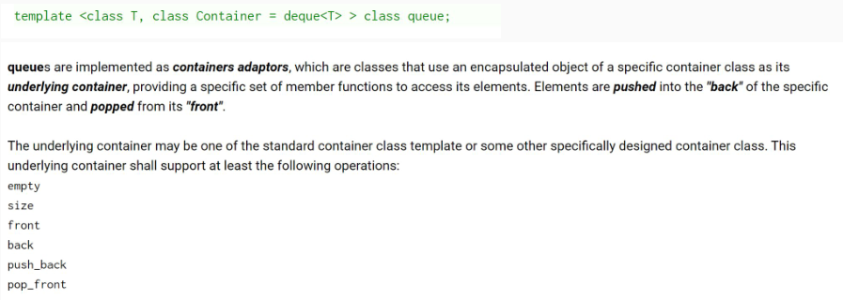
The STL

Slide 8
Agenda
- Iterators
- Pointers

Slide 9
All containers are collections of objects…
So how do we access those objects?
● What if we want to print out everything in a vector?
● Or loop until we find a certain object in a set?
How is this done in the STL?

Slide 10
All containers are collections of objects…
We’d like to have a for-loop, probably!
What would that look like?
Where do we
start?
When do we
end?
something…++???

Slide 11
Introducing Iterators!
Containers all implement something called an iterator to do this!
● Iterators let you access all data in containers programmatically!
● An iterator has a certain order; it “knows” what element will come next
○ Not necessarily the same each time you iterate!

Slide 12
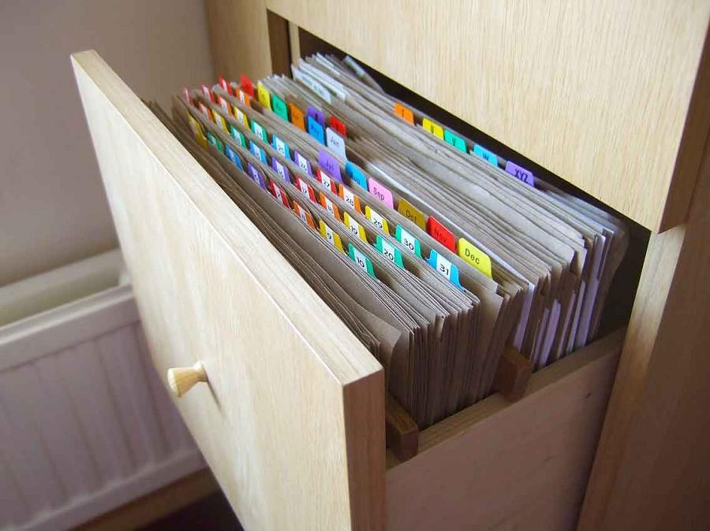
Think of your container as a file cabinet!
An iterator lets you go through the files one at a time!
● You can see where the front and back of your drawer are.
● You can move your finger from one to the next,because you kept your place.
● You can take out any file you’ve your hand on, and read/write whatever you’d like in it.
● You can compare the relative location of any two files just by looking at where they are in the cabinet.

Slide 13
In the STL
All containers implement iterators, but they’re not all the same!
● Each container has its own iterator, which can have different behavior.
● All iterators implement a few shared operations:
○ Initializing iter = s.begin();
○ Incrementing ++iter;
○ Dereferencing *iter;
○ Comparing iter != s.end();
○ Copying new_iter = iter;
What other
behaviors can
iterators have?

Slide 14
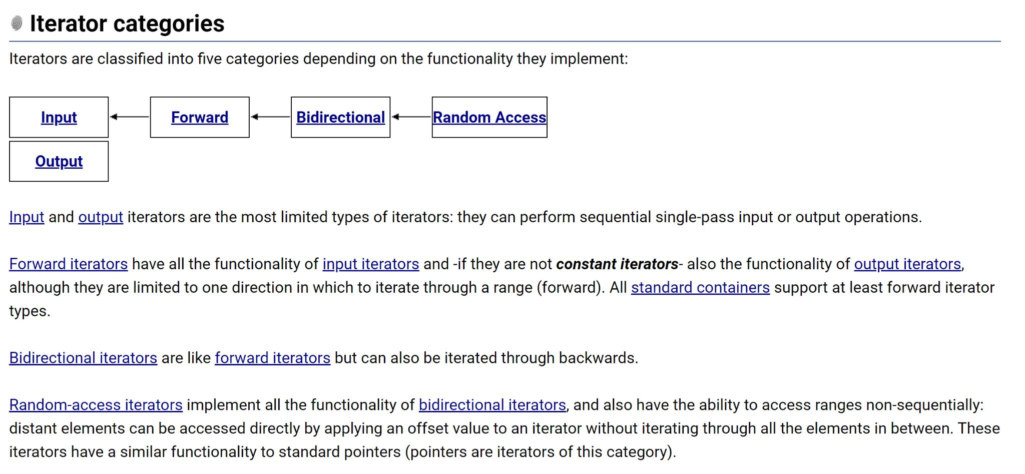
That depends!

Slide 15
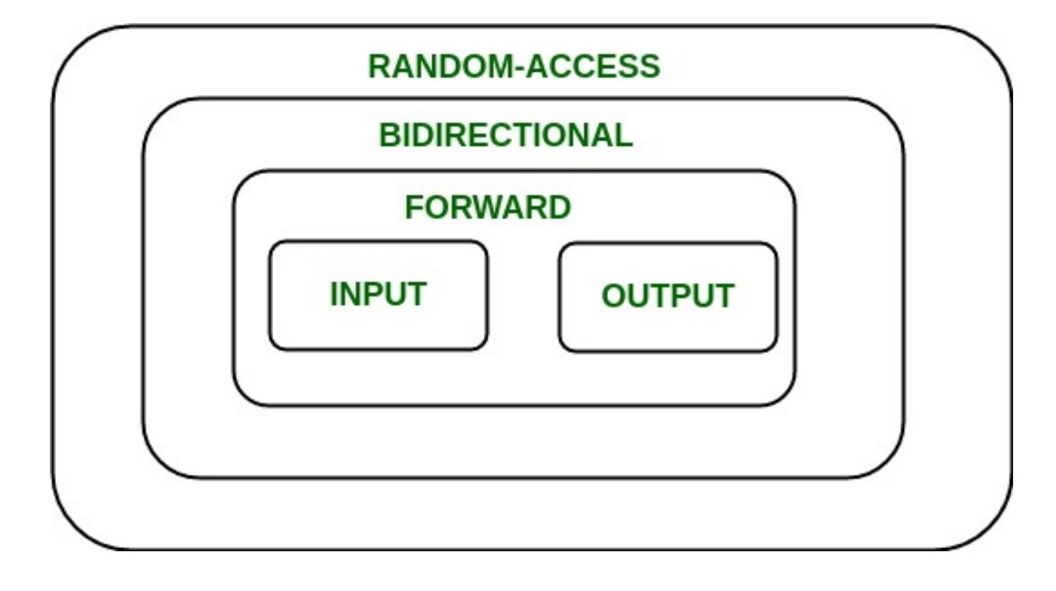
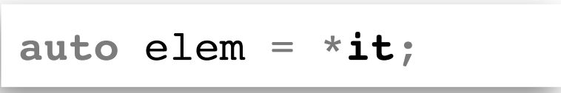
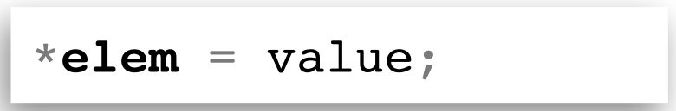
What does that mean?
Forward iterators are the minimum level of functionality for standard containers.
● Input iterators can appear on the RHS (right hand side) of an = operator
● Output iterators can appear on the LHS (left hand side) of an = operator

Slide 16
What does that mean?
Bidirectional iterators can go forward as well as backward!
● --iter;
● Still has the same functionality of forward
iterators!

Slide 17
What does that mean?
Random-access iterators allow you to directly access values without visiting all elements sequentially.
● iter += 5;
● Think of vectors; vec[1] or vec[17] or…
● Be careful not to go out of bounds!
0 | 1 | 2 | 3 | 4 | 5 | 6
iter += 3; ?

Slide 18
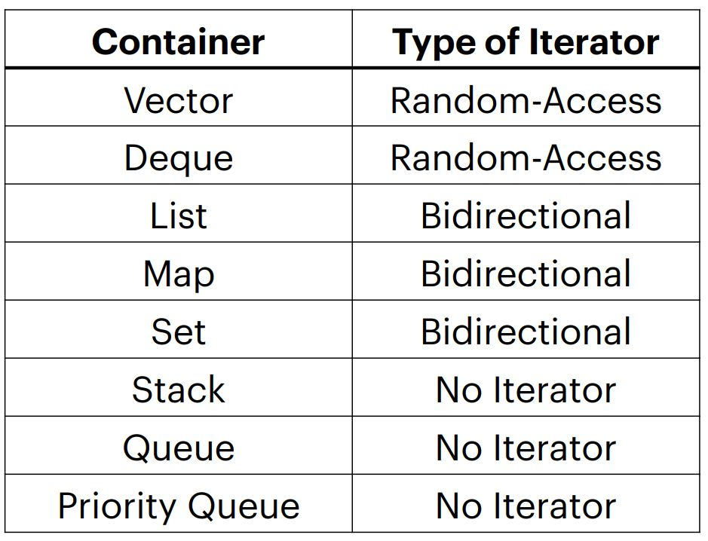
Categorizing STL iterators
Vectors and deques have the most powerful iterators!
● Creating your own containers means creating their iterators as well.
● You can access elements in stacks and queues one-by-one, but you have to change the container to do so!
● Iteration with iterators is const

Slide 19
Why ++iter; ?
Why not iter++; ? There’s a difference in when the value isreturned!
● iter++ returns the value before being incremented.
● ++iter returns the value after being incremented.
Using an iterator, we already have the previous value! It’s slightly more inefficient to use iter++;
This is now outdated!
iter++ to your heart’s content!

Slide 20
Let’s check out that for loop again!
auto iter = set.begin() iter != set.end(); ++iter
Now we can access each element individually!
If we want the element and not just a reference to it, we dereference (*iter).

Slide 21
Let’s check out that for loop again!
If we have a map, we can use structured binding to be more
efficient while dereferencing!
This is a C++ for-each loop!

Slide 22
Agenda
- Iterators
- Pointers

Slide 23
Introducing Pointers!
Iterators are a particular type of pointer!
● Iterators “point” at particular elements in a container.
● Pointers can “point” at any objects in your code!

Slide 24
Memory and You
Variables created in your code take up space on your
computer.
They live in memory at specific addresses.
Pointers reference those memory addresses and not the
object themselves!
int val = 18;
int val
18
int* ptr = &val;
#0106
int* ptr

Slide 25
Dereferencing
Pointers are marked by the asterisk (*) next to the type of
the object they’re pointing at when they’re declared.
The address of a variable can be accessed by using & before
its name, same as when passing by reference!
If you want to access the data stored at a pointer’s address,
dereference it using an asterisk again.
std::cout >> *ptr >> std::endl;
int val
int val = 18;
18
int* ptr = &val;
#0106
int* ptr

Slide 26
What if the object has member variables?
If we need to access a pointer’s object’s member variables,instead of dereferencing (*ptr) and then accessing (.var),there’s a shorthand!
*ptr.var == ptr->var

Slide 27
What’s the difference?
● Iterators are a type of pointer!
● Iterators have to point to elements in a container, but
pointers can point to any object!
○ Why is this? All objects stored inside the big
container known as memory!
● Can access memory addresses with & and the data at
an address/pointer using *

Slide 28
Coding for love, Coding for the world
Qijun Zhao
qjzhao@scu.edu.cn

